Slide 1
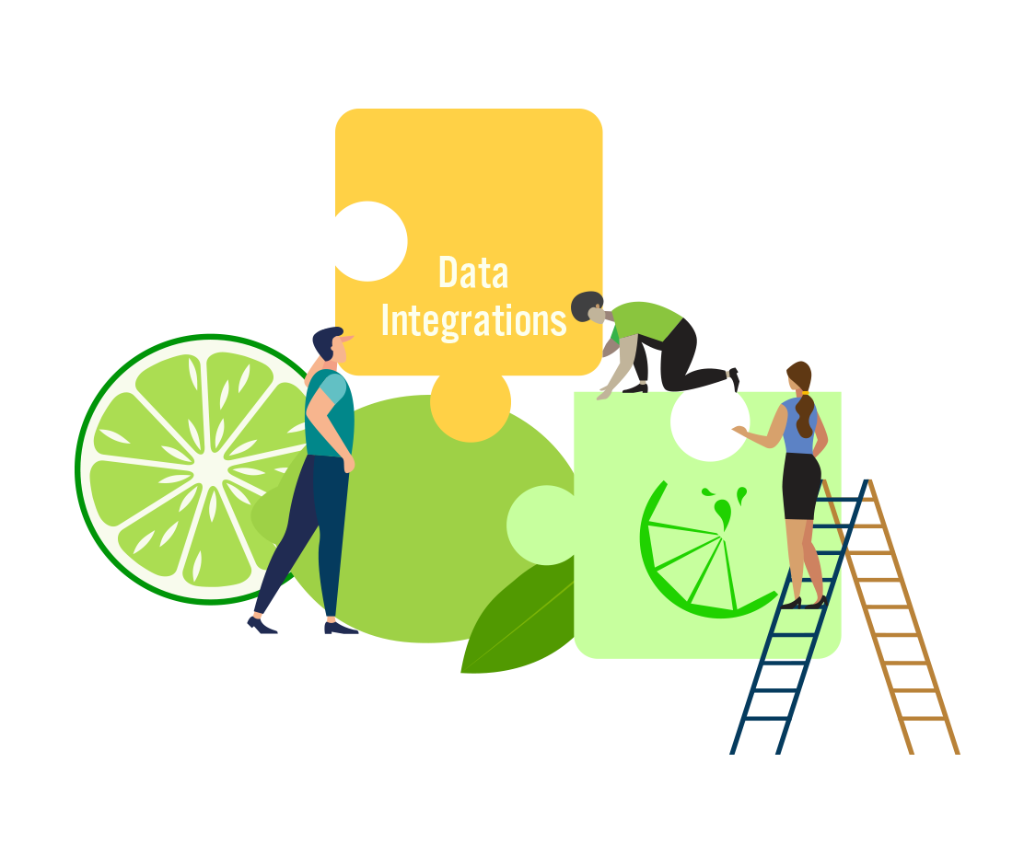
Data Integration Phase
G. Fernando Lojano Mayaguari
Miguel Moraga Muñoz

Slide 2
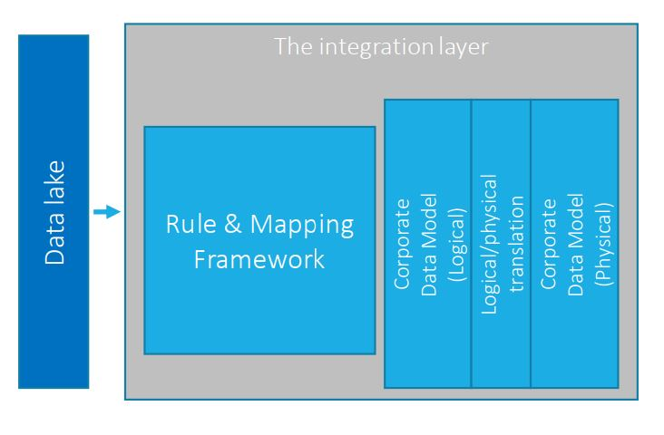
What is Data Integration?
Data integration involves combining data residing in different sources and providing users with a unified view of them.
In our case, the different sources comprise the data lake, and the end result is a physical corporate data model.

Slide 3
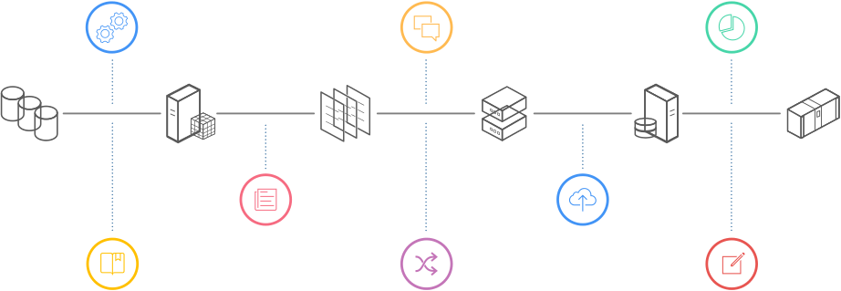
Source-to-target mapping
Set of data transformation instructions that determine how to convert the structure and content of data in the source system to the structure and content needed in the target system.
When you create a mapping, you use operators to define the Extraction, Transformation, and Loading (ETL) operations that move data from a source object to a data warehouse target object.

Slide 4
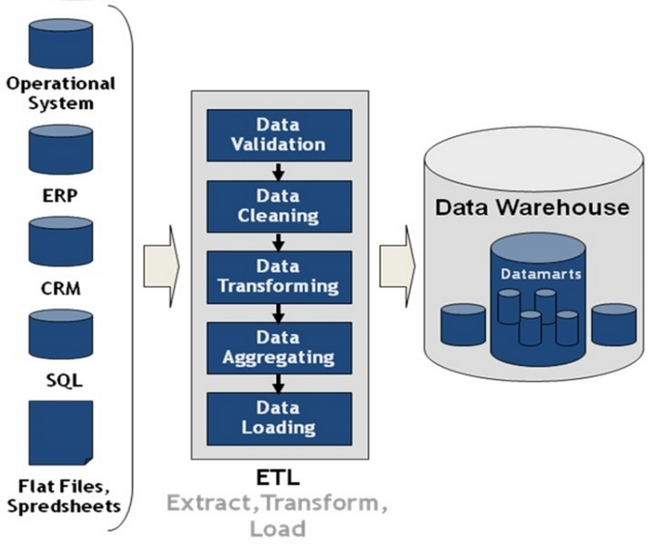
ETL: What is it?
Data Integration Model System
Often used to build data warehouse
3 main phases:
Extract
Transform
Load
Benefits
Challenges & Difficulties

Slide 5
Logical Data Model & Physical Data Model
Logical data model
Physical data model
Describes data needs for a single project but could integrate with other logical data models based on the scope of the project.
Designed and developed independently from the DBMS.
Data attributes will have datatypes with exact precisions and length.
Normalization processes to the model is applied typically till 3NF.
The physical data model describes data need for a single project or application though it maybe integrated with other physical data models based on project scope.
Data Model contains relationships between tables that which addresses cardinality and nullability of the relationships.
Developed for a specific version of a DBMS, location, data storage or technology to be used in the project.
Columns should have exact datatypes, lengths assigned and default values.
Primary and Foreign keys, views, indexes, access profiles, and authorizations, etc. are defined.

Slide 6
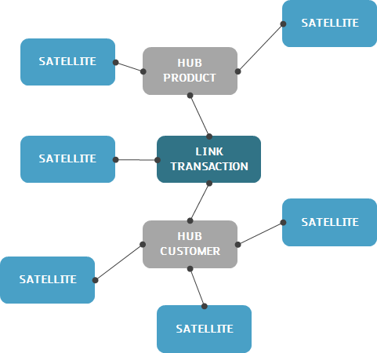
About Data Vault
Hybrid Data Modelling Technology
4 main principles:
Traceability
Non relevant data selection
Tolerance to change
Load speed
3 different table components
Benefits
Challenges & Disadvantages

Slide 7

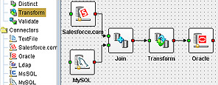
Open Source Data Integration Options
Open Source Tool: Apatar
No coding, just visual job designer
Flexible deployment Options
As there is no coding, non developers can easily use it.
Only ETL approach, it not supports the new approaches as ELT or ETLT
Quite outdated, last update made in 2013.
BUT…..

Slide 8

Open Source Data Integration Options
Open Source Framework: Spark
Provides a number of inter-connected platforms, systems and standards for Big Data projects
A fast open source data processing engine
Makes distributed programming very accessible to data scientists
We will use Spark to easily implement the ETL mapping from the data lake to the logical model (3NF)
Then, we will map the logical model into the physical data model through the data vault modelling method

